Slide 1
















AI in Media
This presentation will provide an introduction to the use of artificial intelligence in various media applications.
Max Meiners
Neil Ross Daniel
Raya-Neda Borisova
Wojciech Stachowiak
Gin Li
Introduction
Conclusion
Executive summary
Implementations & next steps
Literature study
Policy
Methodology
Visuals

Slide 2
Index
Introduction
Conclusion
Executive summary
Implementations & next steps
Literature study
Policy
Methodology
Visuals

Slide 3
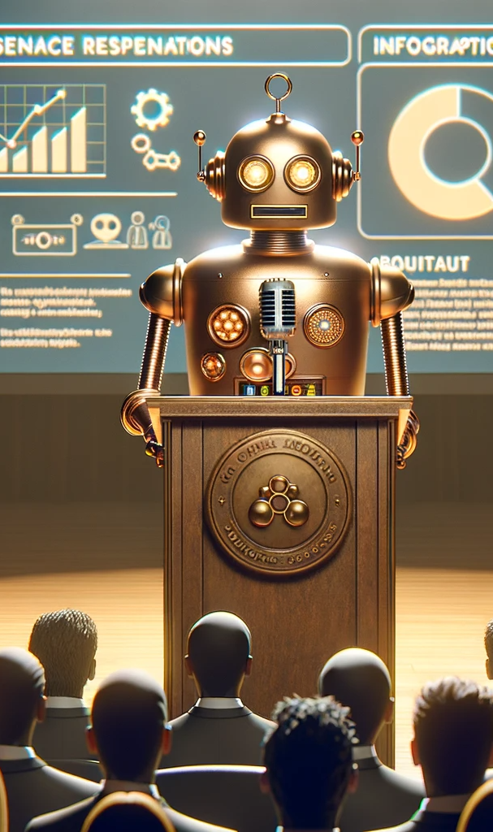
Artificial intelligence (AI) is increasingly used in the media and entertainment industries. AI has the ability to generate art, music, videos, and text, making it a powerful new tool for creators.
However, this revolutionary technology also raises significant concerns about its implications for authenticity and ethics.

Slide 4

Artificial Intelligence isn't merely a tool but a transformative force. It's changing not only how media is produced but also the fundamental dynamics of content creation, distribution, and audience engagement.
Integrating AI in media raises ethical concerns and complexities.

Slide 5




Executive Summary
AI and media overview
AI-generated content
Ethics of AI in media
This presentation covers key aspects of how AI is impacting media and communications.
Discussion on use of AI to create media content like text, images, audio and video.
Examines ethical concerns around use of AI in media like bias, misinformation, and impact on jobs.
The growing role of AI in media and its implications.

Slide 6



Literature Study
AI has been in use for a while, it drives recommendation systems, can already generate art, and group customers to better fit the audience. This technology is older than many think it is. What is new, is the ease of use.
Notes:
AI is not as new as many think
AI is more common than many think
The outburst is not caused by new inventions
It's the ease of use

Slide 7
Literature Study
Content
The gap is slowly closing
Humans are still needed for creative processes
AI content is less robust
Notes:
The gap between human content and AI content is closing
Algorithms are not ready to produce content on their own
Not worth watching
It lacks the robustness of human made storytelling

Slide 8
Literature Study
Production
Growing potential
AI still faces problems
Layout
Resource allocation
Notes:
The potential is growing
AI facing problems
Layout is an issue
Resource allocation is not reliable

Slide 9
Literature Study
Marketing
High potential
Previous use of data
Product recommendation
Personalization
Possible automation
Notes:
High potential
Already used data
Product recommenders
Personalization
Future automation possibililties

Slide 10
Summary
The job market can and will change, this means our students should be prepared for that change.
The aim is to create industry professionals able to work in the field immediately after graduating.
Notes:
If we want to produce industry experts, they need to at least understand breakthrough technologies
It's like knowing software to edit photos, it's a new tool that needs an introduction

Slide 11







Methodology
Research Design
Investigating awareness and perspectives on AI within the media domain
Collected essential variables for analysis
Online survey and interviewed educational staff
Utilized both qualitative and quantitative methods insights

Slide 12
Methodology
Data collection
Online survey conducted using Qualtrics
Distribution through email and flyers with QR codes
Consisted of a general section and domain-specific section
Conducted from October 4, 2023, to October 27, 2023.
Interviews with educators for additional insights
Participants provided consent through a form explaining the study's purpose

Slide 13
Methodology
Procedure
Used R scripts in tidy-verse style for data analysis
Gathered a total of 94 respondents (84 students, 8 lecturers, 1 support staff, 1 management team member).
Received suggestions from ChatGPT for script improvement

Slide 14
Methodology
Ethical considerations
Participants provided informed consent for data analysis to safeguard their rights and privacy
Many participants expressed concerns about AI's increasing impact, particularly regarding copyright issues

Slide 15
Methodology
Validity and reliability
Questions were obtained from previous research, so no need for additional validation
Data exhibits high consistency and reliability for confident replication
Findings and conclusions are robust and applicable to similar scenarios or contexts
The ability to replicate study procedures and outcomes highlights research rigor and dependability

Slide 16

Visuals

Slide 17
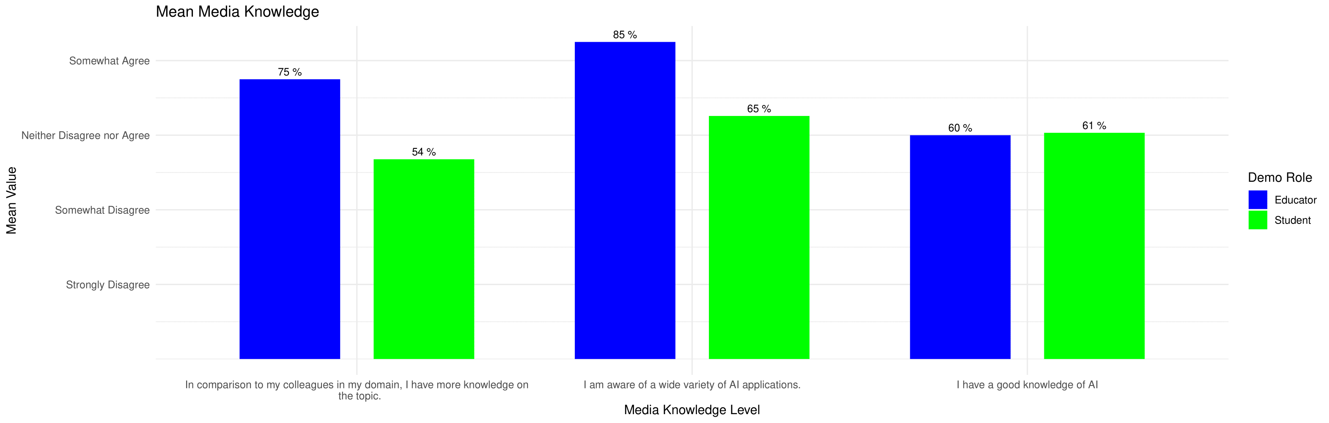
AI knowledge of surveyor

Slide 18
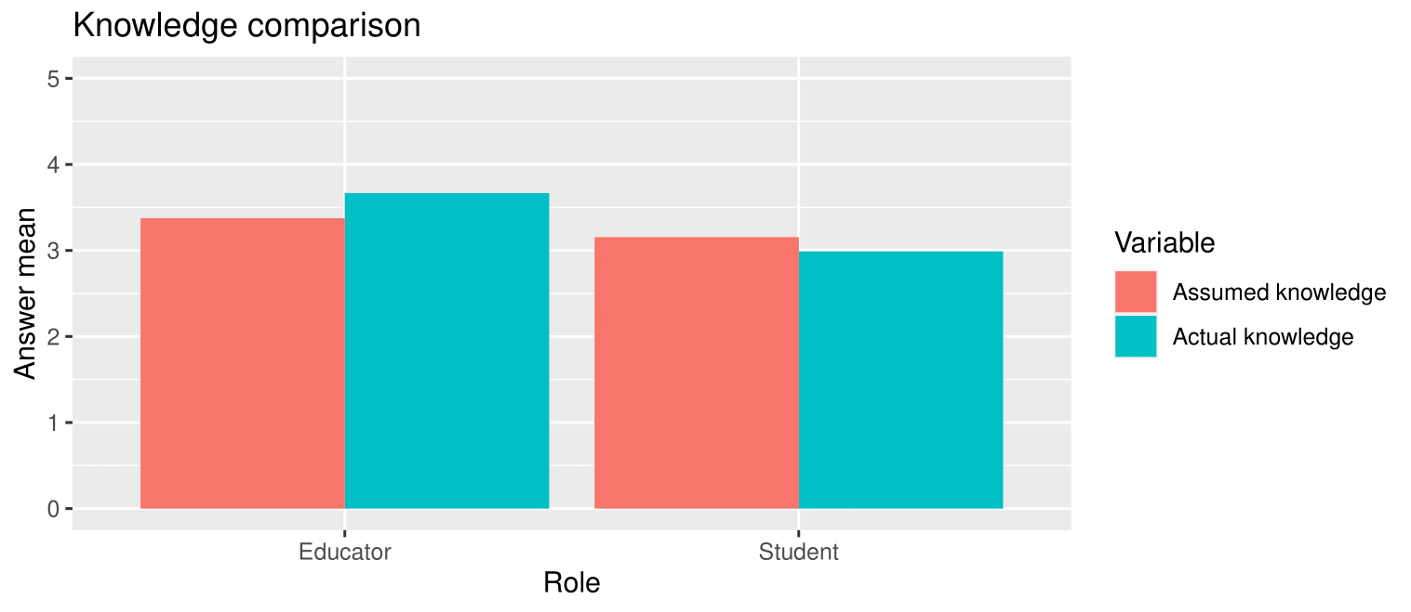
Assumed and actual knowledge comparison

Slide 19
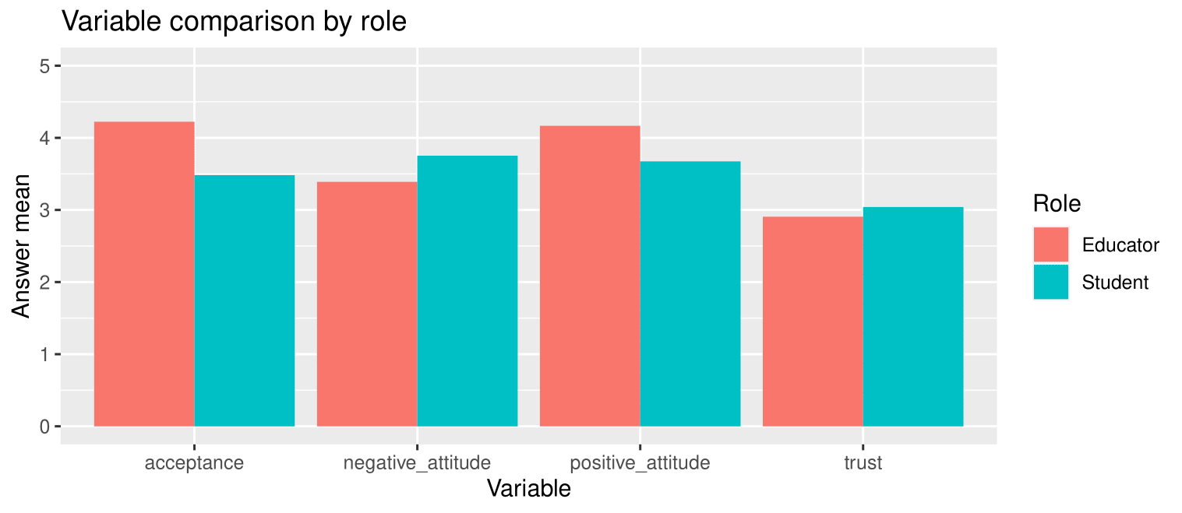
Knowledge comparison

Slide 20
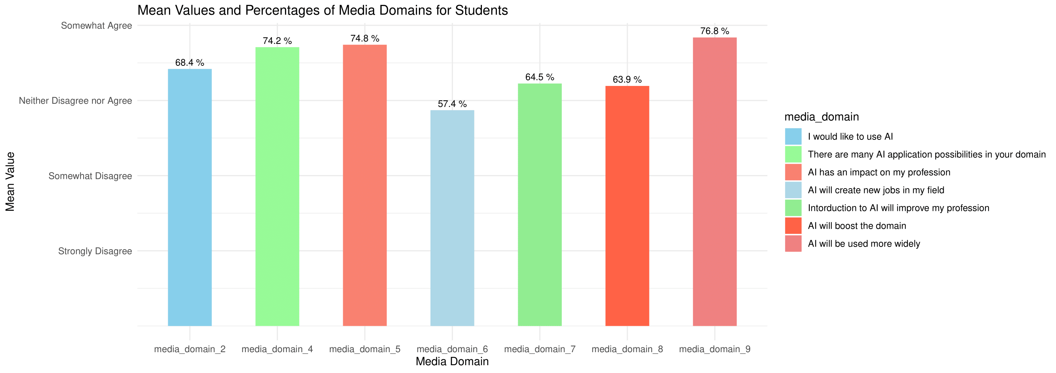
Attitudes

Slide 21
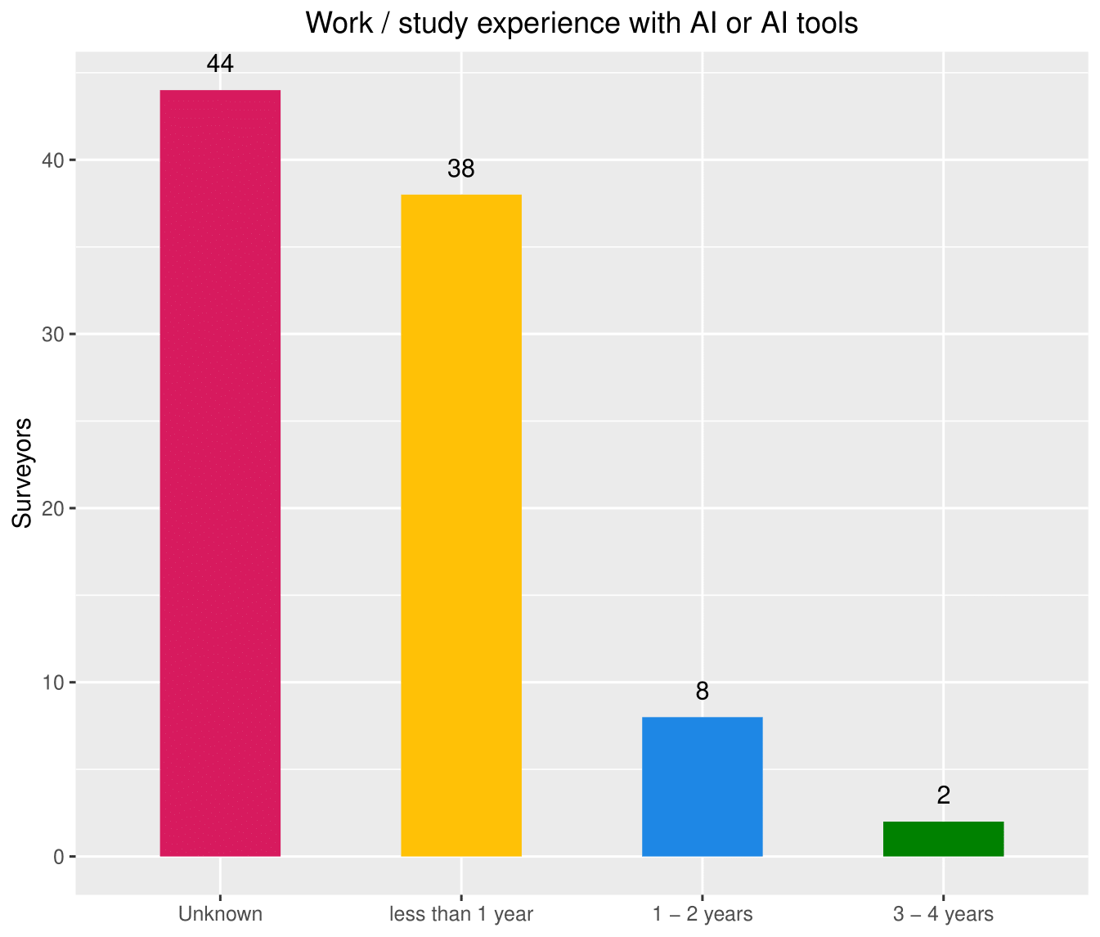
Work/ study experience with AI (tools)

Slide 22
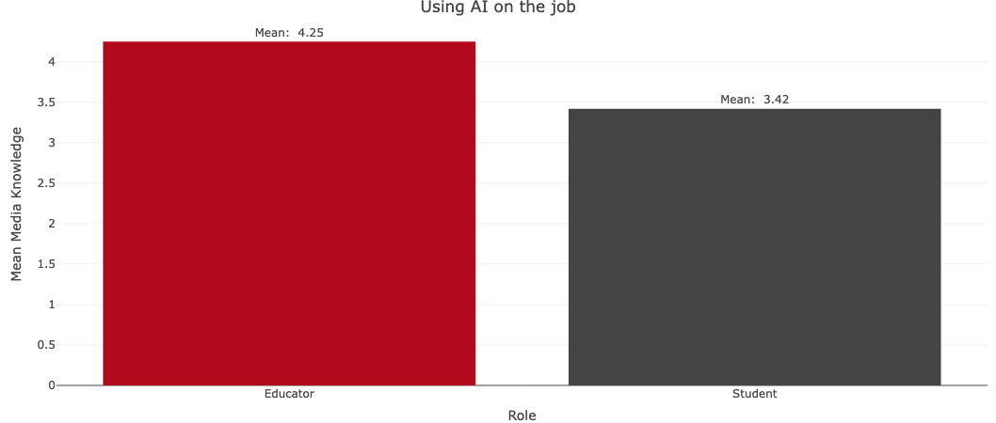
Using AI on the job

Slide 23
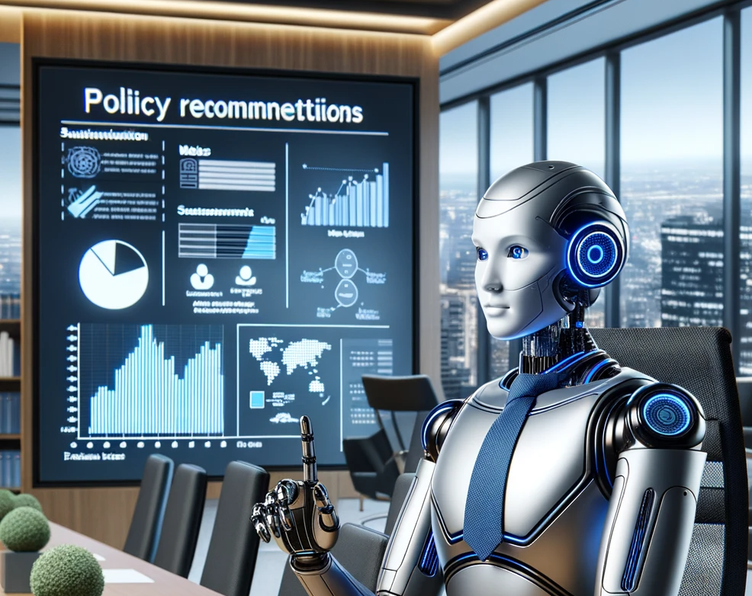
Policy

Slide 24

Policy context
Preserving human creativity
Ethical education, AI training
Accommodate diverse AI knowledge levels
Notes:
Policy Context
Balance AI integration with traditional media studies to preserve human creativity.
Prioritize ethical education, practical AI training, and critical engagement with AI-generated content.
Accommodate diverse AI knowledge levels and maintain core storytelling skills.

Slide 25
Policy recommendations
Current way of teaching + AI
Ethical considerations
Practice for AI tools
Engagement with AI content
Flexible learning
Knowledge disparities
Specialization courses
Notes:
Policy Recommendations
Advocate for integrated media studies curriculum combining traditional teaching with AI integration.
Prioritize ethical considerations and provide practical training in AI tools for students.
Foster critical engagement with AI-generated content to develop well-rounded comprehension.
Accommodate different paces and ensure preparedness for the AI-driven industry.
Bridge AI knowledge disparities through guest lectures, specialized programs, and applied AI courses.
Offer specialization in AI within the media domain (3rd/ final year) to equip professionals with advanced skills in harnessing AI technology.

Slide 26

Implementations &
next steps
Curriculum Development and Faculty training
Form Curriculum Development Committee
Identify core courses (blend of media studies & AI)
Develop course materials (syllabus, lesson plans, resources)
Provide faculty training (AI tools, technical approaches)
Notes:
Form Curriculum Development Committee (experts in media studies & AI)
Identify core courses (blend of media studies & AI)
Develop course materials (syllabus, lesson plans, resources)
Provide faculty training (AI tools, technical approaches

Slide 27
Implementations &
next steps
Resource allocation and support
Ensure access to AI tools and infrastructure
Establish dedicated AI labs/workstations
Arrange guest lectures and industry partnerships

Slide 28
Implementations &
next steps
Risks and Challenges
Establish ethical guidelines for AI use in media
Implement content review process for ethics compliance (Adjust grading system)
Offer specialized workshops for varying AI knowledge levels
Provide extra support resources (tutoring, courses)

Slide 29
Implementations &
next steps
Evaluation
Develop/adjust grading criteria for integrated approach
Review data for adjustments and improvements
Get feedback
Test integrated approach in select courses
Make necessary adjustments to curriculum/methods
Notes:
Develop/adjust grading criteria for integrated approach
Regularly review data for adjustments and improvements
Get feedback from faculty, students, industry partners
Test integrated approach in select courses
Make necessary adjustments to curriculum/methods

Slide 30
Implementations &
next steps
Next steps
Explore research and innovation opportunities in media studies and AI
Continuously update curriculum to reflect industry trends

Slide 31


Conclusion
AI can automate tedious media tasks
AI can generate synthetic media content
AI can help with media discovery and recommendations
AI tools like auto-transcription and auto-subtitling can help media workflows.
Tools like DALL-E 3 allow generating images and videos from text prompts.
Algorithms can suggest relevant media content based on user data and preferences.
AI has many potential applications in the media industry, from assisting in content creation to improving discovery and personalization. But ethical issues around synthetic media need to be addressed.

Slide 32
Conclusion
AI can automate tedious media tasks
AI can generate synthetic media content
AI can help with media discovery and recommendations
AI tools like auto-transcription and auto-subtitling can help media workflows.
Algorithms can suggest relevant media content based on user data and preferences.
Tools like DALL-E 3 allow generating images and videos from text prompts.
AI has many potential applications in the media industry, from assisting in content creation to improving discovery and personalization. But ethical issues around synthetic media need to be addressed.

Slide 33
Conclusion
AI can automate tedious media tasks
AI can generate synthetic media content
AI can help with media discovery and recommendations
AI tools like auto-transcription and auto-subtitling can help media workflows.
Tools like DALL-E 3 allow generating images and videos from text prompts.
Algorithms can suggest relevant media content based on user data and preferences.
AI has many potential applications in the media industry, from assisting in content creation to improving discovery and personalization. But ethical issues around synthetic media need to be addressed.

Slide 34

References
Max W. Meiners:
Integration of AI in the Media studies

Slide 35

References
Neil Ross Daniel:
Perception of Artificial Intelligence by Media domain

Slide 36

References
Wojciech Stachowiak:
Proposing Changes To Media Program Based On Survey Results

Slide 37

References
Raya-Neda Borisova:
Adoption and Impact of Artificial Intelligence in Media education

Slide 38

References
Gin Li:
Exploring AI Integration at Breda University's Media Programs

